Slide 1

Lock & Memory Model
Computer System Engineering, Fall 2019. (IPADS, SJTU)
Implementing the lock
Yubin Xia

Slide 2
Goal: Build Reliable Systems from Unreliable Components
The abstraction that makes that easier is transactions, which provide atomicity and isolation, while not hindering performance
All-or- nothing
shadow copies (simple, poor performance) or logs (better performance, a bit more complex)
Before- or-after
2PL (Two-phase locking) ,
or OCC (Optimistic Concurrency Control)
eventually, we also want transaction-based systems to be distributed: to run across multiple machines

Slide 3
Implementing the Lock

Slide 4
Lock Implementation (Incorrect)
struct lock { integer state; };
void acquire (lock reference L) {
while L.state == LOCKED
; // spin until L is UNLOCKED
L.state = LOCKED; // the while test failed, got the lock
}
void release (lock reference L) {
L.state = UNLOCKED;
}

Slide 5
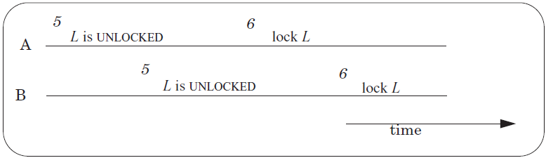
Race Condition Still Exists!
A and B both have the Lock!
Operation-1: Read L to check if its state is LOCKED
Operation-2: Write L to change its state to LOCKED
Not atomic!
Need another lock?
Notes:
How do you handle this in Lab-1?

Slide 6
Primitives to Implement Lock
Software solution
Using load and store instructions only
Dekker's & Peterson's Algorithms
Hardware atomic instruction
RSM: read-set-memory
Test-and-set, Compare-and-swap
Load-linked + Store-conditional, Fetch-and-add

Slide 7
Peterson's Algorithms
int flag[2]; // assume two threads on two CPUs
int turn;
void init() {
flag[0] = flag[1] = 0; // 1->thread wants to grab lock
turn = 0; // whose turn? (thread 0 or 1?)
}
void lock() {
flag[self] = 1; // self: thread ID of caller
turn = 1 - self; // make it other thread's turn
while ((flag[1-self] == 1) && (turn == 1 - self))
; // spin-wait
}
void unlock() {
flag[self] = 0; // simply undo your intent
}

Slide 8
Peterson's Algorithms
Assumptions
Assume loads and stores are atomic with respect to each other, which was true on early hardware
Does not hold on today's hardware, which has relaxed memory consistency models
So, not used any more

Slide 9
Problem: Memory Consistency
Before entering critical section:
After critical section:
flag[i] = true; // i is the CPU ID
turn = 1 - i; // assume only 2 CPUs
while(flag[1 - i] && (turn == (1 - i)));
flag[i] = false;
Programmer's perspective
If flag[1] == false, it means that CPU[1] is not in the critical section
If flag[1] == true and turn == 1 (just set to 1), it means that CPU[1] is in the critical section, so just wait
If flag[1] == true and turn == 0, it means that CPU[1] just sets flag[1] to true, and sets turn to 0, so CPU[1] is waiting, thus CPU[0] can continue
No problem
CPU[0]: W(f[0])1 W(turn)1; R(f[1])1 R(turn)0 go; W(f[0])0;
------------------------------------------------------------------------------
CPU[1]: W(f[1])1 W(turn)0; R(f[0])1 R(turn)0 R(f[0]1)… R(f[0])0 go

Slide 10
Problem: Memory Consistency
Before entering critical section:
After critical section:
flag[i] = true; // i is the CPU ID
turn = 1 - i; // assume only 2 CPUs
while(flag[1 - i] && (turn == (1 - i)));
flag[i] = false;
Assumption
The flag[i] must be set before setting turn
Else, CPU[0] and CPU[1] may be both in critical section!
CPU[0]: W(flag[0])1; turn=1; R(flag[1])1 && R(turn)0; go!!;
------------------------------------------------------------------------------
CPU[1]: W(flag[1])1; turn=0; R(flag[0])0 && R(turn)0; go!!;

Slide 11
Memory Consistency Models
A Case Study on Multi-core Memory Consistency

Slide 12
Memory Consistency
Memory consistency model
Define the behavior of multiple CPU read/write memory
Memory consistency
A read gets the latest write value
What's the Problem on multi-core?
Different CPUs access shared data in memory
Some read, some write

Slide 13
Strict Consistency
P1: W(x)1
-------------------------
P2: R(x)1 R(x)1
Processor P1 writes a value of 1 to variable x; at some later time processor P2 reads x and obtains a value of 1. Then P2 reads it again and should get the same value
P1: W(x)1
-------------------------
P2: R(x)0 R(x)1
P1: W(x)1
-------------------------
P2: R(x)0 R(x)1
This is not valid under strict consistency

Slide 14
Example
Initial: x=y=0
Thread-1: x=1; r1=y;
Thread-2: y=1; r2=x;
Note: no "r1==0, r2==0"
Schedule-1
Schedule-2
Schedule-3
x=1;
r1=y;
x=1;
r1=y;
x=1;
r1=y;
y=1;
r2=x;
y=1;
r2=x;
y=1;
r2=x;
r1==0
r2==1
r1==1
r2==0
r1==1
r2==1
Notes:
from thread's perspective: execution order
from program's perspective: can be any interleaving, but same for each thread (e.g., Execution-1 for any thread)

Slide 15
Sequential Consistency
"… the result of any execution is the same as if the operations of all the processors were executed in some sequential order, and the operations of each individual processor appear in this sequence in the order specified by its program."

Slide 16
Sequential Consistency
P1: W(x)1
-----------------------
P2: R(x)1 R(x)2
-----------------------
P3: R(x)1 R(x)2
-----------------------
P4: W(x)2
Any ordering that could have been produced by a strict ordering regardless of processor speeds is valid under sequential consistency
Equivalent
P1: W(x)1
-----------------------------
P2: R(x)1 R(x)2
-----------------------------
P3: R(x)1 R(x)2
-----------------------------
P4: W(x)2
We can reason about the program itself, with less interference from the details of the hardware on which it is running
P1: W(x)1
-----------------------
P2: R(x)1 R(x)2
-----------------------
P3: R(x)2 R(x)1
-----------------------
P4: W(x)2
This is not valid under sequential consistency.

Slide 17
Sequential Consistency is Weaker
Equivalent
P1: W(x)1
-------------------------
P2: R(x)1 R(x)1
P1: W(x)1
-------------------------
P2: R(x)0 R(x)1
P1: W(x)1
-------------------------
P2: R(x)0 R(x)1
Strict consistency: ✓
Sequential consistency: ✓
Strict consistency: ✓
Sequential consistency: ✓
Strict consistency: ✗
Sequential consistency: ✓
Sequential consistency is weaker than strict consistency
Allow "memory write lag"
But require write propagate at the same time

Slide 18
Cache Coherence != Sequential Consistency
P1: W(x)1 W(y)2
---------------------------------------------
P2: R(x)0 R(x)2 R(x)1 R(y)0 R(y)1
---------------------------------------------
P3: R(y)0 R(y)1 R(x)0 R(x)1
---------------------------------------------
P4: W(x)2 W(y)1
Constrains:
R(x): 0 -> 2 -> 1
R(y): 0 -> 2 -> 1
P2 & P3 both think:
P4's W(x)2 -> P1's W(x)1
P1's W(y)2 -> P4's W(y)1
P2 thinks:
P1's W(x)1 -> P4's W(y)1
P3 thinks:
P4's W(y)1 -> P1's W(x)1
P2 saw (x,y)=(1,0)
P3 can never see it
P3 saw (x,y)=(0,1)
P2 can never see it

Slide 19
Cache Coherence VS. Sequential Consistency
Difference
Sequential consistency requires a globally consistent view of memory operations
Cache coherence only requires a locally consistent view
E.g., for local variable x or y, all CPUs see the same order; but for (x,y), different CPUs may see different orders
Based on cache implementation
This couldn't happen with a snoopy-cache based scheme
But it could happen with a directory based scheme

Slide 20
Processor Consistency
Also known as PRAM consistency
PRAM: Pipelined Random Access Memory
Definition
Writes done by a single processor are received by all other processors in the issue order
But writes from different processors may be seen in a different order by different processors
Consider the networks (on chip) latency between different nodes

Slide 21
Processor Consistency
P1: W(x)1 W(x)2
----------------------------------
P2: R(x)2 R(x)1
P1: W(x)1
-----------------------
P2: R(x,y)1,0 R(x,y)1,1
-----------------------
P3: R(x,y)0,1 R(x,y)1,1
-----------------------
P4: W(y)1
This is not valid under processor consistency
This is not valid under sequential consistency
But is valid under processor consistency
The processors are connected in a linear array, like this:
Cycle-1: P1 and P4 write their values and propagate them
Cycle-2: the value from P1 has reached P2, the value from P4 has reached P3
Cycle-3: the values have made it two hops
P1
P2
P3
P4

Slide 22
Java Memory Model
Let the user decide critical section
Only ensure sequential consistency with in the critical section
For non-sync multi-thread program, only provide minimal support
Ensure no uninitialized read by zeroing heap and free memory
Note: JVM is a virtual machine, so it has its own memory consistency model

Slide 23
Atomic Instructions
Atomicity by hardware

Slide 24
Test-and-set Instruction
History
Burroughs B5000 in the early 1960's
1 int TestAndSet(int *old_ptr, int new) {
2 int old = *old_ptr; // fetch old value at old_ptr
3 *old_ptr = new; // store 'new' into old_ptr
4 return old; // return the old value
5 }

Slide 25
Spin Lock using Test-and-set
1 typedef struct __lock_t {
2 int flag;
3 } lock_t;
4
5 void init(lock_t *lock) {
6 // 0 indicates that lock is available, 1 that it is held
7 lock->flag = 0;
8 }
9
10 void lock(lock_t *lock) {
11 while (TestAndSet(&lock->flag, 1) == 1)
12 ; // spin-wait (do nothing)
13 }
14
15 void unlock(lock_t *lock) {
16 lock->flag = 0;
17 }

Slide 26
Compare-and-swap
Another hardware primitive
Compare-and-swap (on SPARC)
Compare-and-exchange (on x86)
1 int CompareAndSwap(int *ptr, int expected, int new) {
2 int actual = *ptr;
3 if (actual == expected)
4 *ptr = new;
5 return actual;
6 }

Slide 27
Spin Lock using Compare-and-swap
1 typedef struct __lock_t {
2 int flag;
3 } lock_t;
4
5 void init(lock_t *lock) {
6 // 0 indicates that lock is available, 1 that it is held
7 lock->flag = 0;
8 }
9
10 void lock(lock_t *lock) {
11 while (CompareAndSwap(&lock->flag, 0, 1) == 1)
12 ; // spin-wait (do nothing)
13 }
14
15 void unlock(lock_t *lock) {
16 lock->flag = 0;
17 }

Slide 28
Load-linked and Store-conditional
1 int LoadLinked(int *ptr) { 2 return *ptr; 3 } 4 5 int StoreConditional(int *ptr, int value) { 6 if (no one has updated *ptr since the LoadLinked to this address) { 7 *ptr = value; 8 return 1; // success! 9 } else { 10 return 0; // failed to update 11 } 12 }

Slide 29
Using LL/SC to Build a Lock
1 void lock(lock_t *lock) {
2 while (1) {
3 while (LoadLinked(&lock->flag) == 1)
4 ; // spin until it's zero
5 if (StoreConditional(&lock->flag, 1) == 1)
6 return; // if set-it-to-1 was a success: all done
7 // otherwise: try it all over again
8 }
9 }
10
11 void unlock(lock_t *lock) {
12 lock->flag = 0;
13 }

Slide 30
Fetch-and-add Instruction
1 int FetchAndAdd(int *ptr) {
2 int old = *ptr;
3 *ptr = old + 1;
4 return old;
5 }

Slide 31
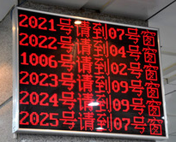
Using Fetch-and-add for Ticket Lock
1 typedef struct __lock_t {
2 int ticket;
3 int turn;
4 } lock_t;
5
6 void lock_init(lock_t *lock) {
7 lock->ticket = 0;
8 lock->turn = 0;
9 }
10
11 void lock(lock_t *lock) {
12 int myturn = FetchAndAdd(&lock->ticket);
13 while (lock->turn != myturn)
14 ; // spin
15 }
16
17 void unlock(lock_t *lock) {
18 lock->turn = lock->turn + 1;
19 }
One difference with previous locks: it ensures progress for all threads

Slide 32
Bootstrapping
Solve the narrow problem using some specialized method
Might work for only that case
It takes advantage of the specific situation
The general solution then consists of two parts:
a method for solving the special case
a method for reducing the general problem to the special case

Slide 33
Bootstrapping (In the case of ACQUIRE)
The solution for the specific problem is
Hardware: building a special hardware instruction that is itself is a before-or-after action
Software: by some extremely careful programming

Slide 34
Assumptions
Bus arbiter
Guarantees that any single LOAD or STORE is a before-or-after action with respect to every other LOAD and STORE
Each entry of the shared array is:
in its own memory cell
the memory provides read/write coherence for memory cells
The instructions execute in program order

Slide 35

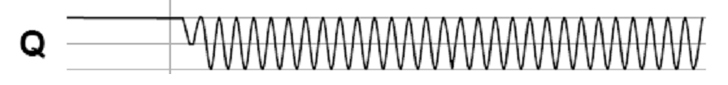
The Bus Arbiter Problem
A:
Arbiter
S:
A:
B:
Clock:
B:
Clock:
S:
t_{E}
Two async inputs (A, B), one sync output
Choose between two asynchronous input
If inputs are closely spaced
Output may be oscillating
Waiting longer only reduce the probability of oscillating

Slide 36
Lock Performance

Slide 37
Lock Granularity
Systems can be distinguished by number of locks and the amount of share data they protect
Developer must choose a locking scheme to provides the need amount of concurrency
Frequently concurrency leads to complexity

Slide 38
Lock Granularity
Course-grain – Few locks protecting more data
+ Simpler, easier to reason about
- Less concurrency
Fine-grain – Many locks protecting smaller pieces of data
+ High amount of concurrency
- More complex
- Overhead for locks

Slide 39
Example: Locks for File System
Consider a file system that has a move() function
Move a file from one directory to another
Step-1: removing the file from directory 1
unlink from directory 1
Step-2: Place the file in directory
link to directory 2
move(dir1, dir2, filename)
unlink(dir1, filename)
link(dir2, filename)

Slide 40
Approach 1: Coarse-grained Locking
move(dir1, dir2, filename):
acquire(fs_lock)
unlink(dir1, filename)
link(dir2, filename)
release(fs_lock)
fs_lock: one lock per file system
Forbid possible concurrency:
move(dir1, dir2, file1.txt)
move(dir3, dir4, file2.txt)

Slide 41
Approach 2: Fine-grained Locking
move(dir1, dir2, filename):
acquire(dir1.lock)
unlink(dir1, filename)
release(dir1.lock)
acquire(dir2.lock)
link(dir2, filename)
release(dir2.lock)
Where is the file?

Slide 42
Approach 3: Fine-grained Locking + Holding Both Locks
move(dir1, dir2, filename):
acquire(dir1.lock)
acquire(dir2.lock)
unlink(dir1, filename)
link(dir2, filename)
release(dir1.lock)
release(dir2.lock)
A: move(M, N, file1.txt)
B: move(N, M, file2.txt) // M and N swapped
Deadlock!
Notes:
A will first acquire the lock for M. Concurrently, suppose B acquires
its first lock, which is for N. Now, A needs to acquire a lock for N,
and B needs to acquire a lock for M. But they can't! The other CPU
holds the lock, and won't release it.

Slide 43

Deadlock

Slide 44
Deadlock
If we had modified the code so that both threads acquire the locks in the same order
(L1 and then L2, or vice versa)
No deadlock could have occurred
Again, small changes in the order of statements can result in good or bad behavior

Slide 45
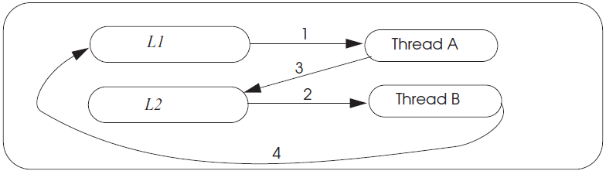
Deadlock wait-for Graph

Slide 46
Deadlock Theory
Four necessary and enough conditions for deadlock
Limited access
Resource can only be shared with finite users.
No preemption
Once resource granted, cannot be taken away.
Multiple independent requests (hold and wait)
Don't ask all at once (wait for next resource while holding current one)
Cycle in wait for graph

Slide 47
Deadlock & Making Progress
Inevitable if using locks in concurrency
1. Waiting for one another
2. Waiting for a lock by some deadlocked one
Correctness arguments ensures correctness, but no progress
Methods
Pessimistic ones: take a priori action to prevent
Optimistic ones: detect deadlocks then fix up

Slide 48
Methods for Solving Deadlock
Lock ordering (pessimistic)
Number the locks uniquely
Require transactions acquire locks in order
Problem: some app may not predict all of the locks they need before acquiring the first one

Slide 49
Methods for Solving Deadlock
Backing out (optimistic)
Allow acquire locks in any order
If it encounters an already-acquired lock with an number lower than one it has previously acquired itself, then
UNDO: Back up to release its higher-numbered locks
Wait for the lower-numbered lock and REDO

Slide 50
Methods for Solving Deadlock
Timer expiration (optimistic)
Set a timer at begin_transaction, abort if timeout
If still no progress, another one may abort
Problem: how to chose the interval?

Slide 51
Methods for Solving Deadlock
Cycle detection (optimistic)
Maintain a wait-for-graph in the lock manager
Shows owner and waiting ones
Check when transaction tries to acquire a lock
Prevent cycle (deadlock)
Select some cycle member to be a victim

Slide 52
Approach 4: Fine-grained Locking + Solving Deadlock
move(dir1, dir2, filename):
if dir1.inum < dir2.inum:
acquire(dir1.lock)
acquire(dir2.lock)
else:
acquire(dir2.lock)
acquire(dir1.lock)
unlink(dir1, filename)
link(dir2, filename)
release(dir1.lock)
release(dir2.lock)
dir.inum is the inumber of a directory
Requires global reasoning about all locks
Need a way to ensure locks are acquired in the same order
Aka., ordered locking

Slide 53
Livelock
An interaction among a group of threads
Each thread is repeatedly performing some operations
E.g., context saving/restoring
But never able to complete the whole sequence of operations
E.g., process the network packets

Slide 54
One-writer Principle
If each variable has only one writer
Coordination becomes easier
Concurrency and read-only data is easy
Guide: Make as much data as you can have only a single writer
Privatization: Make data private to a thread
Allocate on thread stack
Array indexed by thread_id()
E.g. privateData[thread_id()]...
Focus locking scheme on data shared read/write

Slide 55
Reference
Our text book: Chap-5.2
3-easy-pieces: Chap-28

Slide 56
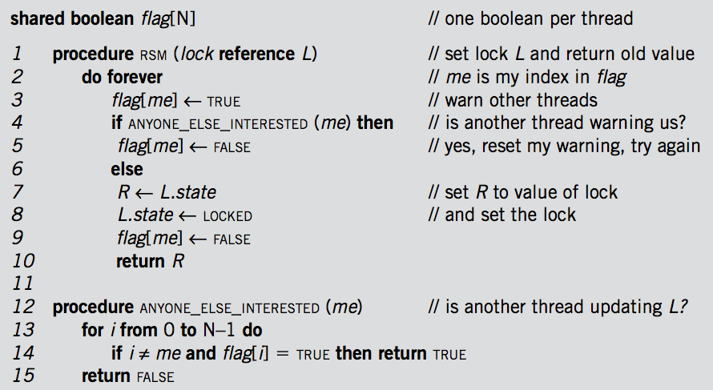
Recall the Code Snippet for Mutual Exclusive in Lec-9

